Slide 1
Capstone Project-5
Project Title Live Class Monitoring System ( Face Emotion Recognition ) TEAM MEMBERS Jai Harish S Pranil Thorat Ashik Kumar Saransh Srivastava

Slide 2
Content:
Introduction
Problem Statement
Data summary
Model Overview
Accuracy and Loss Curves
Confusion Matrix
Real-Time Face Emotion Detection
Webapp Development
Deployment in Cloud
Challenges
Conclusion

Slide 3
Introduction:
For the past ten years, the Indian education system has been undergoing rapid changes due to the expansion of web-based learning services, specifically education platforms.
During a lecture in a physical classroom, the teacher can see the students' faces and gauge their mood, and adjust their lecture accordingly, whether they are going fast or slow.
They can identify students who want additional attention, but they are unable to see all students or access the mood in digital classrooms due to the usage of a video telephony software application (ex: Zoom). Students are unable to focus on content due to a lack of supervision as a result of this issue.
Physical monitoring is limited on digital platforms, but they do come with the power of data and machines that can work for you. Deep learning algorithms may be used to examine its data, which not only solves the surveillance problem but also eliminates human bias from the system.

Slide 4
Problem Statement:
The aim of the project is to create a Facial Emotion Recognition System (FERS) that can detect students' emotional states in e-learning systems that use video conferencing.
This technology instantly conveys the emotional states of the students to the educator in order to create a more engaged educational environment.
Our results supported those of other studies that have shown that in e-learning systems, it is possible to observe the motivation level of both the individual and the virtual classroom.

Slide 5
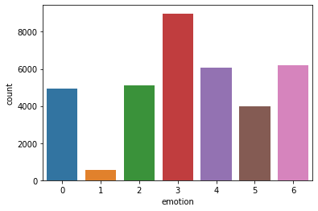
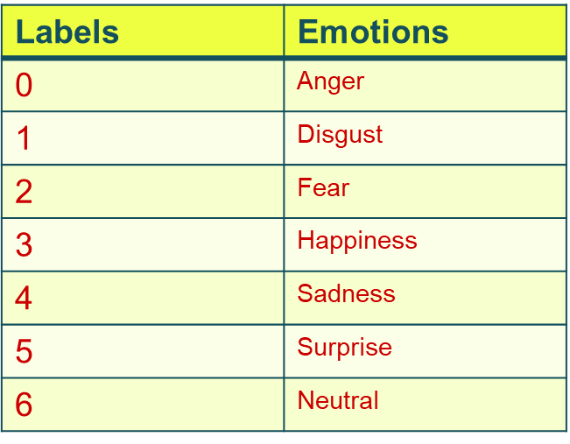
Data summary:
Make Link open
Dataset link:- https://www.kaggle.com/deadskull7/fer2013
After looking at the bar plot, we can see that the bulk of the classes are 3: Happy, 4: Sad, and 6: Neutral, while 1: Disgust and 5: Surprise are less common, and 0: Anger is also common.

Slide 6
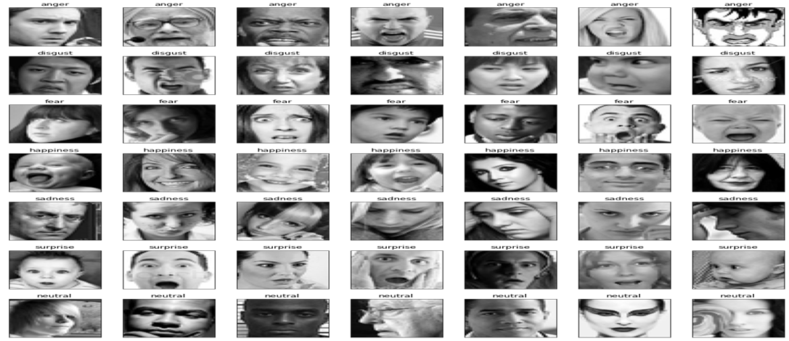
Data Summary Cont.
This dataset contains 35887 grayscale 48x48 pixel face images with seven emotions.

Slide 7
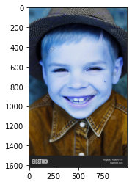
Model Overview:
1] DeepFace Model:-
We imported the above image, which appears to be an 8–12 year old boy, but our model returned a result of "19–22 year old white happy man." We opted to train our own model in order to achieve better outcomes.

Slide 8
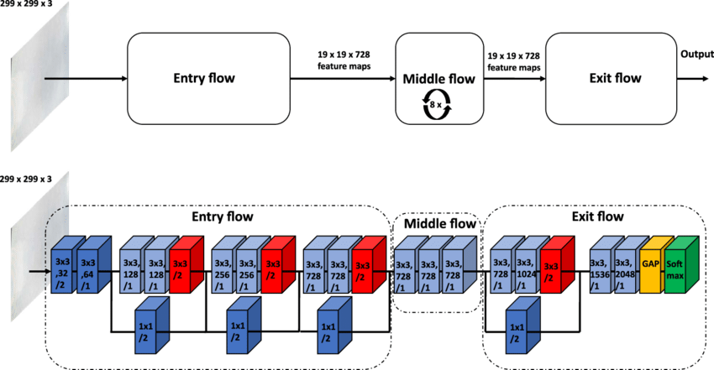
Model overview cont.
2] Xception Model:-

Slide 9
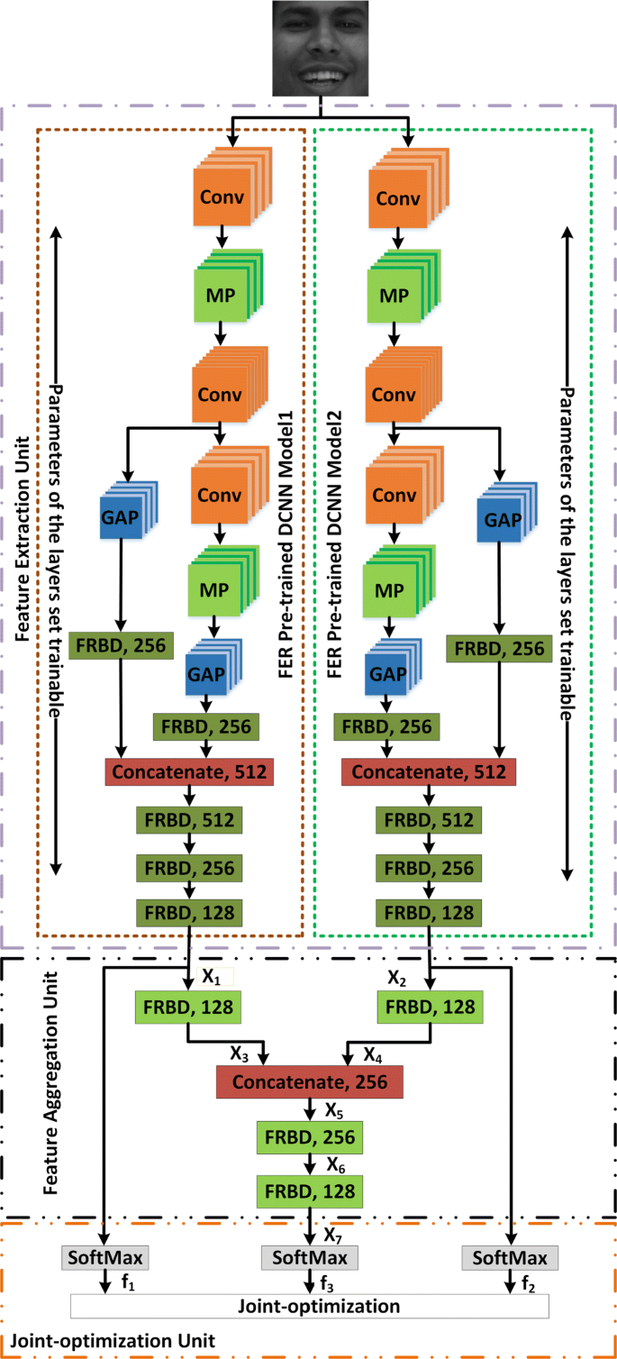
Model overview cont.
3] Dexpression Model:-

Slide 10
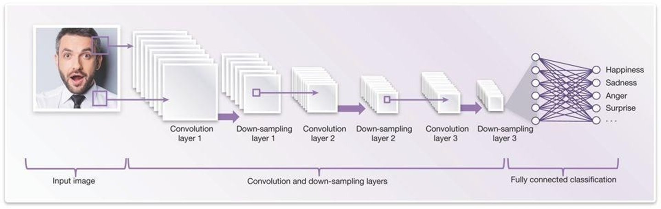
Model overview cont.
4] CNN Model:-

Slide 11
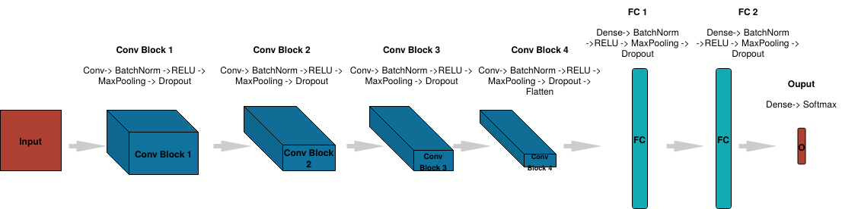
Model overview cont.
5] Dcnn(ResNet):-

Slide 12
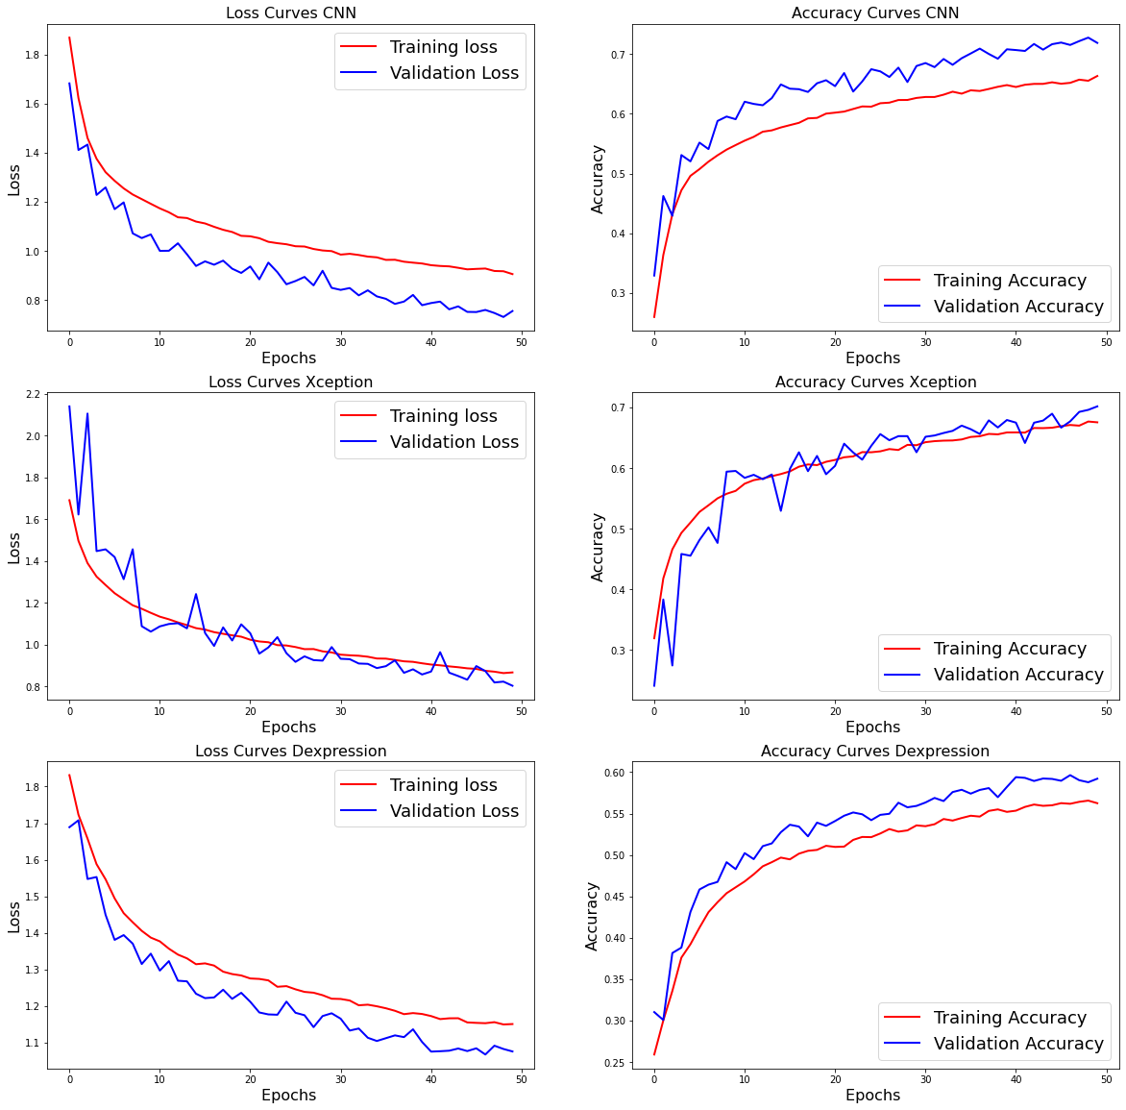
Accuracy and Loss Curves:-

Slide 13
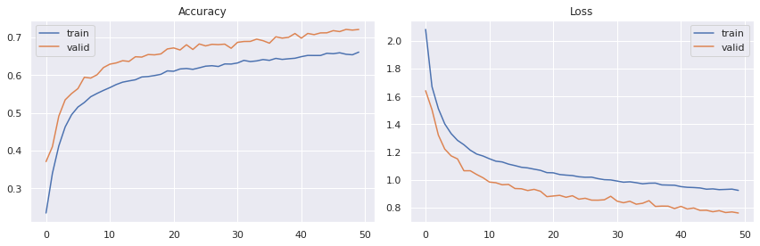
Accuracy and Loss Curves cont.
The dcnn (ResNet) model's accuracy and loss curves are plotted above, and we've finalised it and are using it to recognise faces due to its high accuracy on both training and validation data.

Slide 14
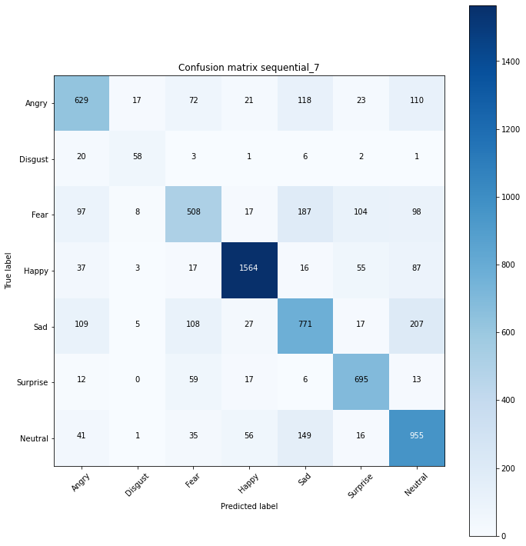
Confusion Matrix:-
precision recall f1-score support 0 0.666 0.635 0.650 990 1 0.630 0.637 0.634 91 2 0.633 0.499 0.558 1019 3 0.918 0.879 0.898 1779 4 0.615 0.620 0.618 1244 5 0.762 0.867 0.811 802 6 0.649 0.762 0.701 1253 accuracy 0.722 7178 macro avg 0.696 0.700 0.696 7178 weighted avg 0.722 0.722 0.720 7178
Confusion Matrix For CNN

Slide 15
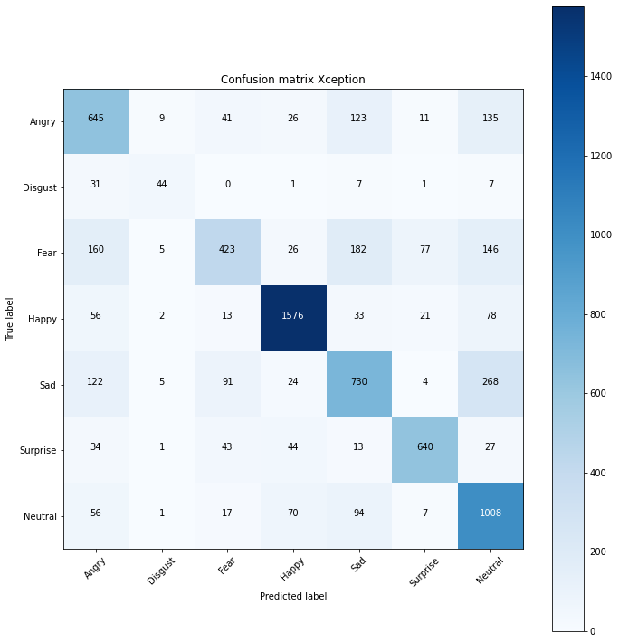
Confusion Matrix cont.
Confusion Matrix For Xception

Slide 16
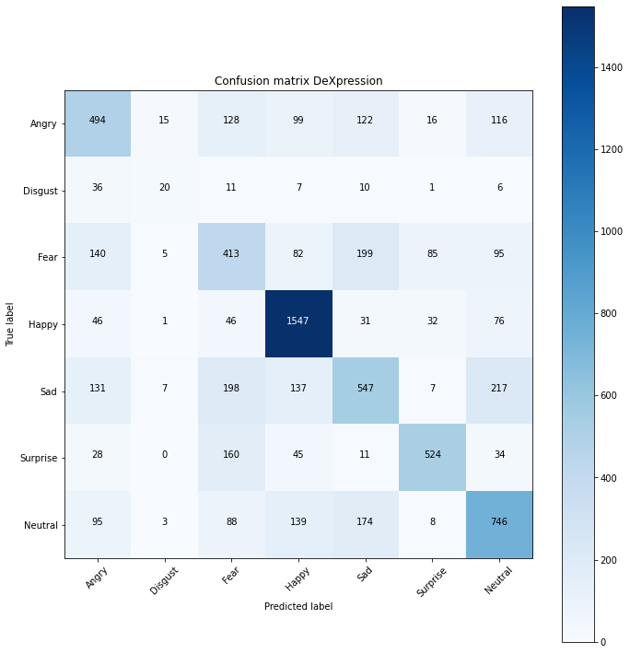
Confusion Matrix cont.
Confusion Matrix For DeXpression

Slide 17
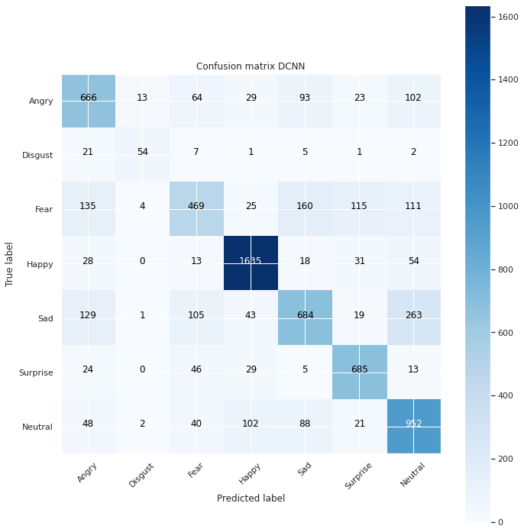
Confusion Matrix cont.
Confusion Matrix For DCNN

Slide 18
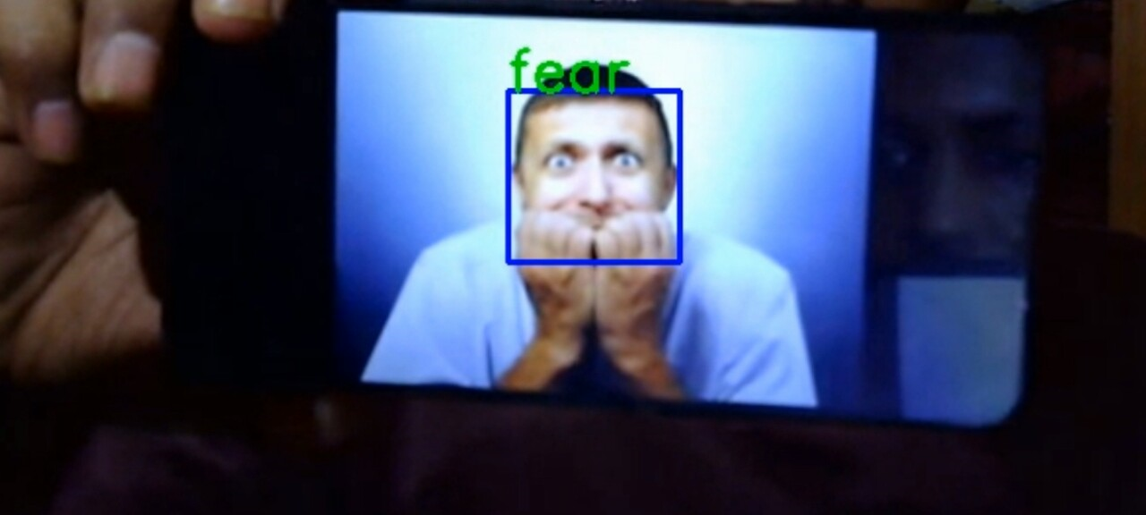
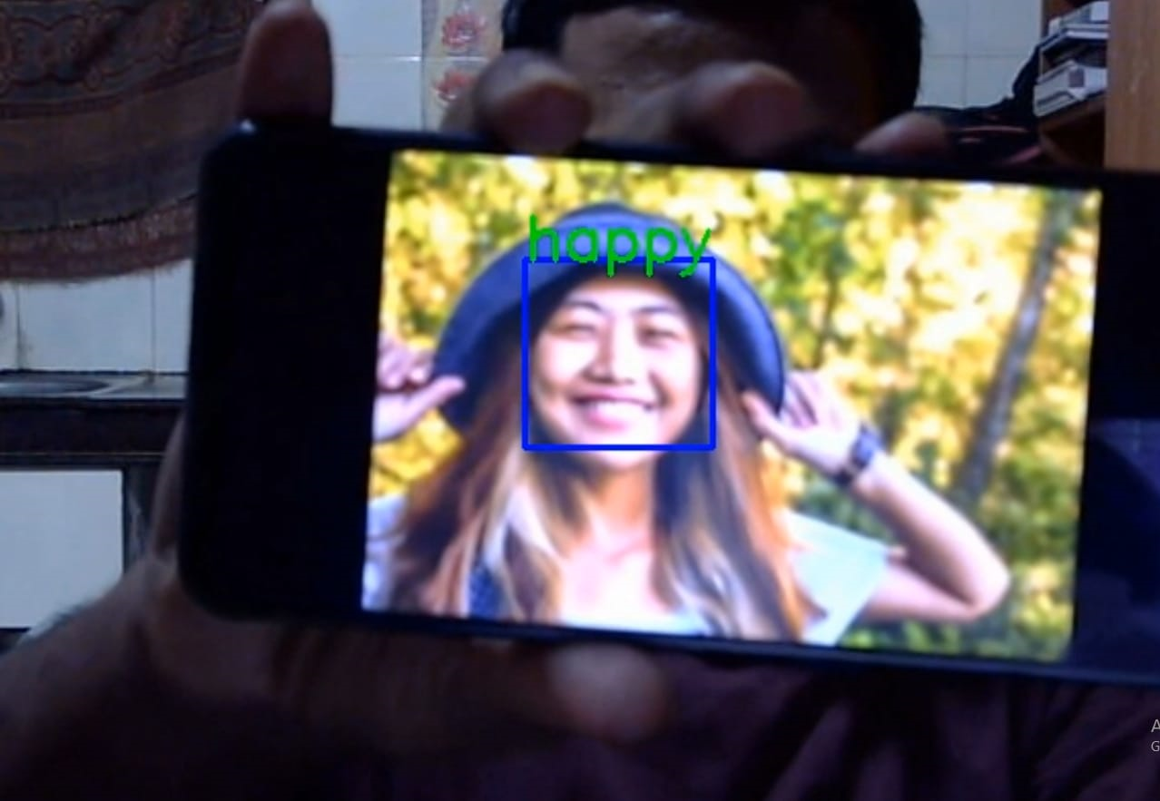
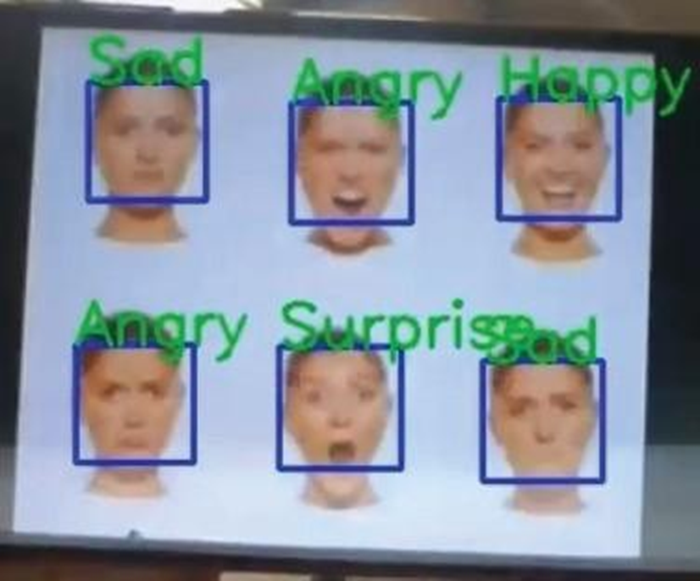
Real-Time Face Emotion Detection:-

Slide 19
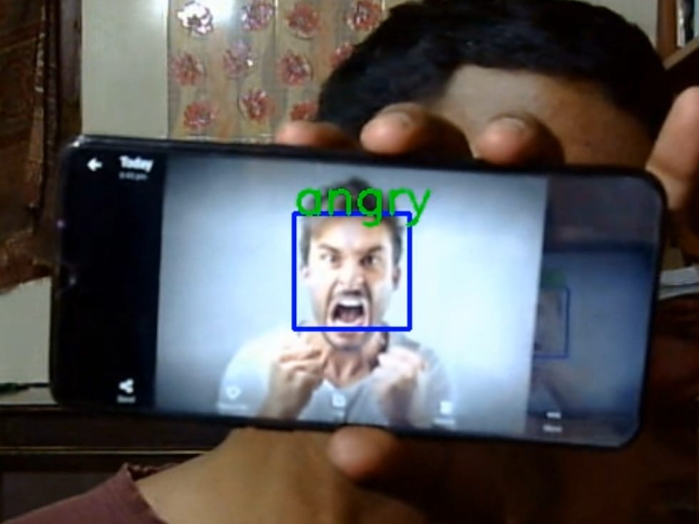
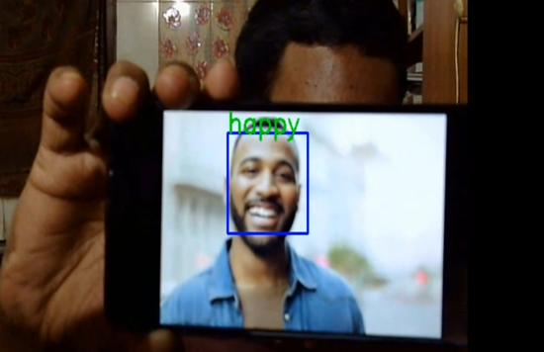
Real-Time Face Emotion Detection cont.

Slide 20

Webapp Development:-
Creating Web App Using Streamlit:-
Streamlit is a Python framework for developing machine learning and data science web apps that is open-source. Using Streamlit, we can quickly create web apps and deploy them. You can use Streamlit to make an app the same way you'd make a Python programme. It's possible with Streamlit. Working on the interactive loop of coding and viewing results is a pleasure.In the web application.

Slide 21

Deployment in Cloud:-
Deploy Web App in AWS:-
AWS (Amazon Web Services) is a comprehensive, evolving cloud computing platform provided by Amazon that includes a mixture of infrastructure as a service (IaaS), platform as a service (PaaS), and packaged software as a service (SaaS) offerings.
https://share.streamlit.io/jaiharish-passion07/facial_emotion/app.py

Slide 22
Challenges:-
To handle a large image dataset.
Selecting the number of filters and neurons.
Select a batch size to avoid the system crashing.
GPU connection to our notebook.
Deployment.

Slide 23
Conclusion:-
We started this project with two objectives: to achieve the highest level of accuracy and to implement our model into practice in the real world.
Among the models tested were Deepface, CNN, dexpression, ResNet, and Xception.
ResNet has the highest accuracy of all, with a validation set accuracy of 72 percent and a training set accuracy of 66 percent.
As a result, we save the Resnet model and use it for facial expression prediction.
A front-end model was successfully created and run on a local web server using Streamlit.
On Amazon's AWS cloud platform, the Streamlit web application has been successfully deployed.

Slide 24
Thank You
Thank You

